Slide 1
PC Maintenance: Preparing for A+ Certification
Chapter 6: Memory

Slide 2
Chapter 6 Objectives
Differentiate between types of memory
Understand how memory holds data
Identify physical types of RAM
Explain how an OS uses RAM
Differentiate between conventional, upper, expanded and extended memory
Get RAM usage information in an OS

Slide 3
Types of Memory
Read-Only Memory (ROM)
Random Access Memory (RAM)
  Dynamic RAM (DRAM)
  Static RAM (SRAM)

Slide 4
Read-Only Memory (ROM)
Non-volatile
Types of ROM chips:
  Programmable ROM (PROM)
  Erasable Programmable ROM (EPROM)
  Electrically Erasable Programmable ROM (EEPROM)

Slide 5
Random Access Memory (RAM)
SRAM
  Non-volatile
  Examples: L1 and L2 caches
DRAM
  Volatile
  Examples: system RAM, video RAM

Slide 6
How RAM Stores Data
Each chip has a grid of on/off capacitors
Each RAM chip’s grid has a width and depth, like a spreadsheet
A bank is a group of chips with a collective width matching the bus
1 | 0 | 1 | 1 | 0 | 0 | 1 | 1
0 | 1 | 1 | 1 | 0 | 1 | 1 | 0
1 | 1 | 0 | 0 | 1 | 1 | 0 | 0
1 | 0 | 1 | 0 | 1 | 0 | 1 | 1

Slide 7
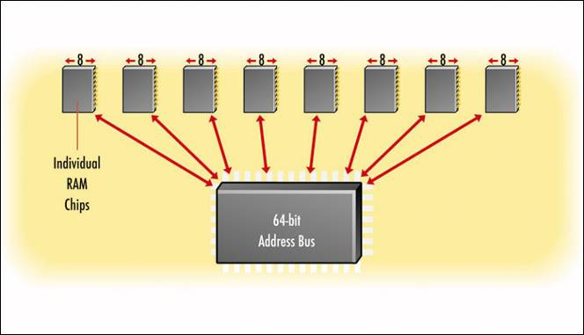
How RAM Stores Data
Multiple chips combine their widths to match the width of the bus

Slide 8
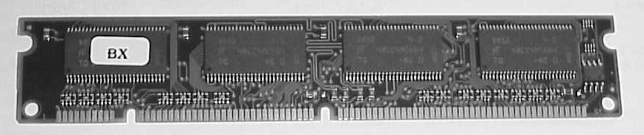
What is a Stick of RAM?
Stick: A SIMM or DIMM that holds a group of chips

Slide 9
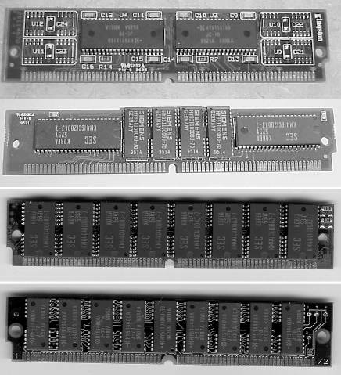
SIMMs
Single Inline Memory Modules (SIMMs)
  30-pin (8-bit)
  72-pin (32-bit)
  Both are now obsolete

Slide 10
DIMMs
Dual Inline Memory Modules (DIMMs)
  168-pin (64-bit)
  SDRAM synchronized with system bus
  DDR SDRAM is double the system bus speed

Slide 11
RIMMs
Rambus Inline Memory Modules (RIMMs)
  184-pin (64-bit)
  Faster than DIMMs
  Up to 8X or more of the system bus speed
  More expensive, less popular
  Waning in popularity

Slide 12
How Many Sticks Per Bank?
SIMMs
  Four 30-pin SIMMs make up a 32-bit bank
  One 72-pin SIMM makes up a 32-bit bank
  Two 72-pin SIMMs make up a 64-bit bank
DIMMs and RIMMs
  One 168-pin DIMM makes up a 64-bit bank
  One 184-pin RIMM makes up a 64-bit bank

Slide 13
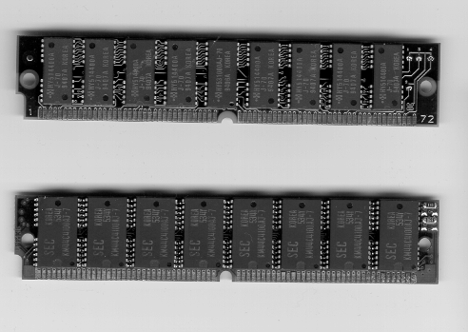
RAM Parity
One-bit parity chip for error correction
Primarily found on 72-pin SIMMs, now mostly obsolete
Later variant was Error Code Correction (ECC) RAM

Slide 14
RAM Speeds
Fast Page Mode (FPM)
  Speed measured in nanoseconds of delay
  Lower number is better
Synchronous Dynamic RAM (SDRAM)
  Speed synchronized with system bus
  Measured in MHz
  Higher number is better

Slide 15
Selecting RAM
Physical size of the stick (number of pins)
Capacity
Speed
Refresh technology
Parity

Slide 16
Understanding Memory Addresses
A logically assigned location in RAM
Described using hexadecimal
Width of address bus determines available addresses

Slide 17
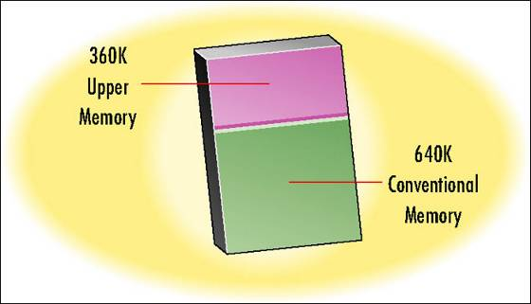
The First Megabyte
640K Conventional Memory
  Running Applications in Real-Mode
360K Upper Memory
  Reserved for system use

Slide 18
Expanded Memory
Developed for 80286 systems
EMS (Expanded Memory Specification)
Also called LIM memory (Lotus-Intel-Microsoft)

Slide 19
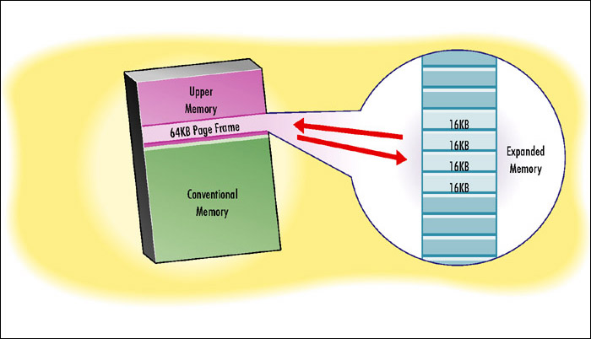
Expanded Memory
Swaps data into and out of a 64K page frame in upper memory

Slide 20
Extended Memory
Originally developed for 80386 systems
Can be accessed directly by protected-mode applications
HIMEM.SYS required
XMS (Extended Memory Specification) is the standard
Still in use today

Slide 21
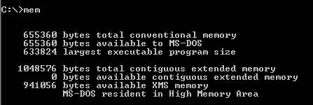
DOS Memory Usage
Use the MEM command

Slide 22
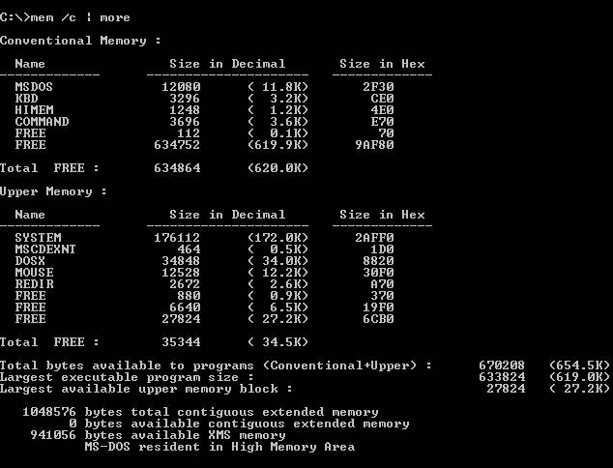
DOS Memory Usage
The MEM /C | MORE command provides more information

Slide 23
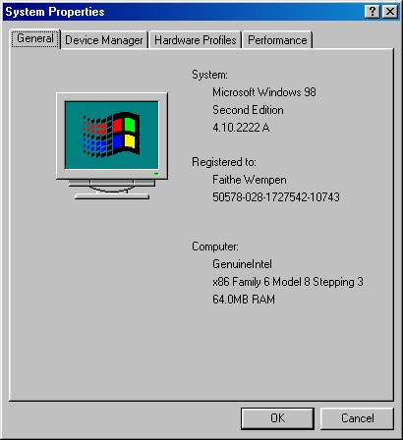
Windows Memory Usage
Mostly automatic
Check amount of RAM in System Properties

Slide 24
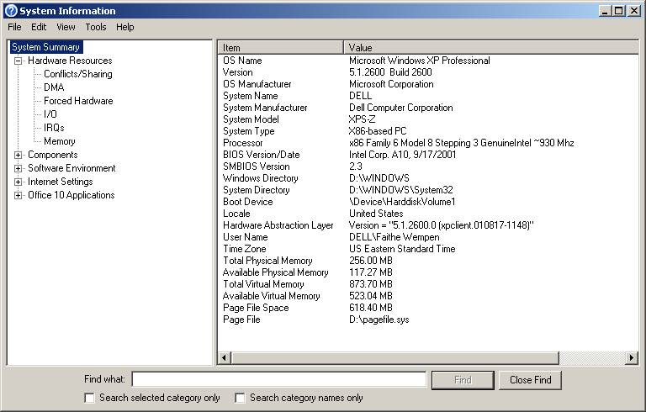
System Information

Slide 25
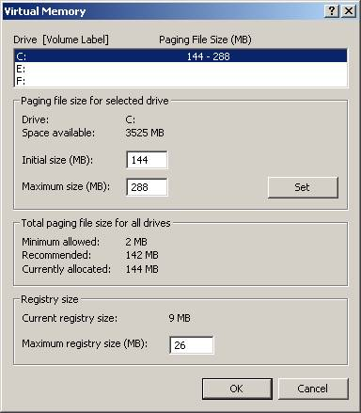
Virtual Memory
Windows automatically controls virtual memory, but settings can be overridden

